Slide 1
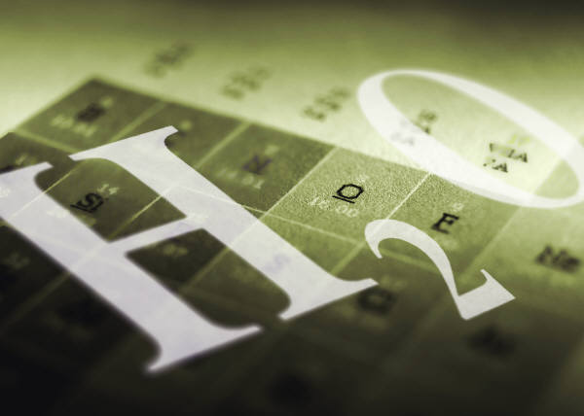
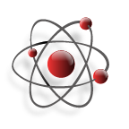
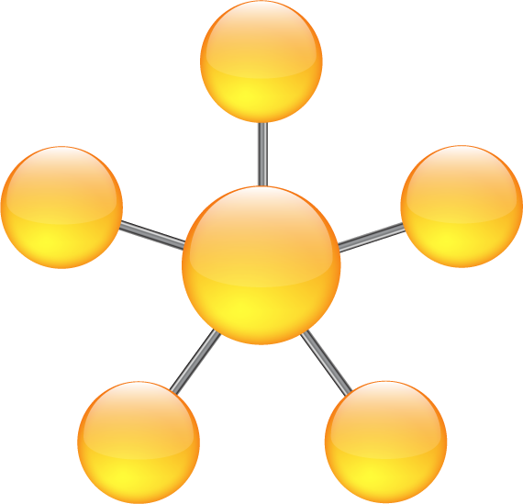
Chemical Quantities
Counting the particles

Slide 2
Counting particles
Which will be easier to count, grains of rice or pieces of paper?
When you buy popcorn, do they come in different sizes or they go by piece?
How do we count objects that are so tiny? Or that is great in number?
How can you make counting easy?

Slide 3
What is matter made up of?
Atoms
Molecules
Ions

Slide 4
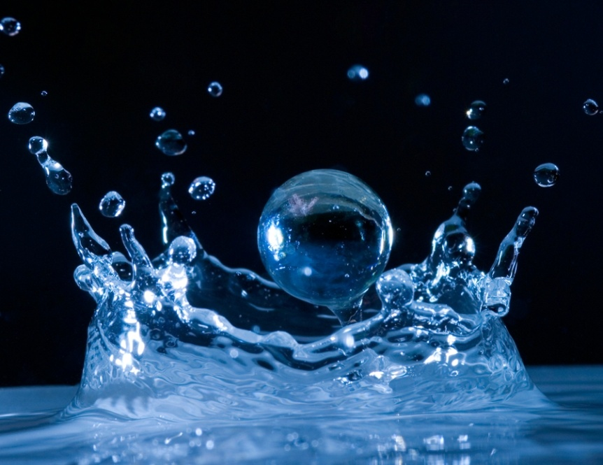
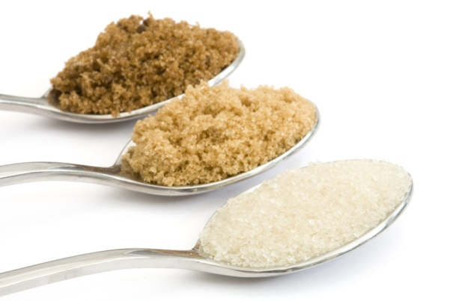
Analogy
Similarly, how do we count atoms, or molecules? They are so tiny and we can’t even see them…
How many molecules of water are in a drop of water?
How many molecules are in a spoonful of sugar?

Slide 5
What is a MOLE?
It is counting unit used to a specified number of particles.
It is a metric/SI unit for measuring the amount of substance.

Slide 6
So, in counting particles
We use the Counting unit: Mole
Equal to: 6.022 x 10 ²³ representative particles
Knowns as: Avogadro’s number
Named in honor of : Amadeo Avogadro

Slide 7
Analogy of using mole
Similar to a dozen
A dozen is 12 counts ( all the time)
  1 dozen egg= 12 eggs
  1 dozen donut= 12 donuts
A mole is 6.02 x 10 ²³ particles
All the time

Slide 8
Analogy:
This means:
In every dozen there are 12 counts
In every mole there are 6.02 x 10²³ particles
Dozen:12 ; mole: 6.02 x 10²³ particle

Slide 9
What other counting units do you know of?
Ream of paper: 500 sheets
Gross of pencil: 144 pcs

Slide 10
So
1 mole of water (H₂O) is composed of 6.02 x 10 ²³ molecules
1 mole of Salt (NaCl) is composed of 6.02 x 10 ²³ formula units
1 mole of gold (Au) is composed of 6.02 x 10 ²³ atoms
1 mole of Aluminum ion Al⁺³is 6.02 x 10 ²³ ions
( How are they similar? Different?)

Slide 11
Kinds or Representative particles
particles
molecules
atom
ions
Formula unit

Slide 12
Atoms
Made up of the same element
Examples:
Carbon C, Iron (Fe), or All elements in Periodic table

Slide 13
Ions
Charged atoms
Cations (+) Anions (-)
Na⁺, Ca⁺²
N⁻³, F⁻

Slide 14
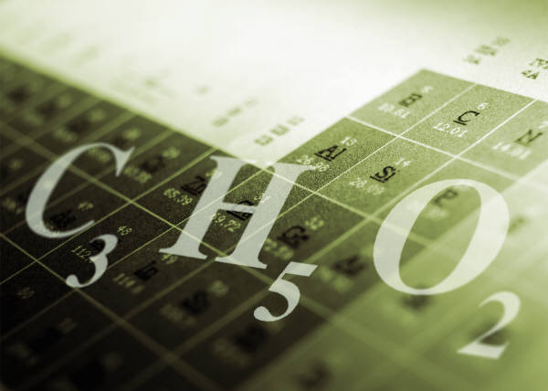
Molecule
A covalent compound, made up of nonmetals
Diatomic gases (H₂, N₂, O₂ , F₂, Cl₂, Br₂ and I₂ )
Examples:
H₂O, sugar C₁₂H₂₂O₁₁, carbon dioxide CO₂

Slide 15
Formula unit
Ionic compound (metal and a nonmetal)
Examples:
Salt: sodium chloride, NaCl,
Magnesium carbonate MgCO₃
Lithium oxide, Li₂O
Metal

Slide 16
Checking for understanding 1:
How many representative particles are in one mole?
6.022 x 10²³ particles

Slide 17
Checking for understanding 2:
Identify the type of representative particle. Why?
1. Al⁺³
Ion
2. Ca₃N₂
Formula unit
3. NH₃
molecule
4. Silver, Ag
Atom

Slide 18
Hydrates
Compound that has specific water molecules bound to each formula unit
Examples:
Copper (II) sulfate pentahydrate=
CuSO₄.5H₂O
Calcium chloride dihydrate= CaCl₂.2H₂O
Sodium sulfate decahydrate= Na₂SO₄.10H₂O

Slide 19
Mole and Molar mass
Molar mass :
mass in grams of 1 mole of a substance
Unit: a.m.u = atomic mass unit
or grams per mole g
mol
AKA: molecular mass or molecular weight

Slide 20
Calculating
Molar or molecular weight
Find the atomic mass/weight in the Periodic table
Examples (molecule)
Water H₂O
Type of atom | Number of atoms |  | Atomic mass ( periodic table) | subtotal
H | 2 | x | 1.0 = | 2
O | 1 | x | 16 . 0 = | 16
 |  |  | Total: | 18 g/ mol

Slide 21
Molecule
Sugar C₁₂H₂₂O₁₁
Types of atoms | Number of atoms | multiply | Atomic mass | Subtotal
C | 12 | x | 12.0 = | 144
H | 22 | x | 1 .0 = | 22
O | 11 | x | 16.0 = | 176
 |  |  | Total: | 342 g/ mol

Slide 22
Formula unit (ionic compound)
Aluminum Sulfate Al₂(SO₄)₃
Types of atoms | Number of atoms | multiply | Atomic mass | Subtotal
Al | 2 | x | 27 = | 54
S | (1x3)=3 | x | 32.1 = | 96.3
O | (4x3)=12 | x | 16 = | 192
 |  |  | Total: | 342.3 g/mol

Slide 23
Formula unit (ionic compound)
Magnesium chloride hexahydrate (MgCl₂.6H₂O)
Types of atoms | Number of atoms | multiply | Atomic mass | Subtotal
Mg | 1 | x | 24.3 = | 24.3
Cl | 2 | x | 35.5 = | 71
H | (6x2)=12 | x | 1.0 = | 12
O | (6x1)=6 | x | 16 = | 96
 |  |  | Total: | 203.3 g/ mol

Slide 24
Molecule
Acetic Acid (vinegar) CH₃COOH
Types of atoms | Number of atoms | multiply | Atomic mass | Subtotal
C | 1 | x | 12 = | 12
H | 4 | x | 1 = | 4
O | 2 | x | 16 = | 32
 |  |  | Total: | 60.0 g/ mol

